Slide 1
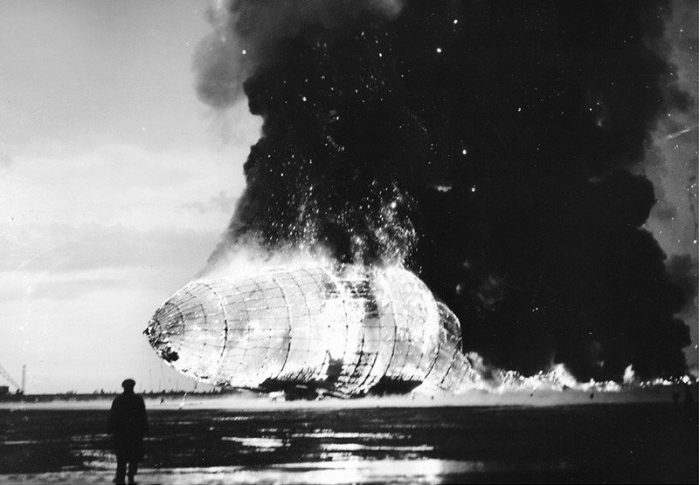
Chapter 8: The Atmospheric Gases and Hydrogen
General Chemistry
Principles and Modern Applications
Petrucci • Harwood • Herring
8th Edition
Philip Dutton
University of Windsor, Canada
Prentice-Hall © 2002
Notes:
Thermochemistry branch of chemistry concerned with heat effects accompanying chemical reactions.
Direct and indirect measurement of heat.
Answer practical questions: why is natural gas a better fuel than coal, and why do fats have higher energy value than carbohydrates and protiens.

Slide 2
Contents
8-1 The Atmosphere
8-3 Nitrogen
8-4 Oxygen
8-5 The Noble Gases
8-6 Hydrogen
Focus on The Carbon Cycle

Slide 3
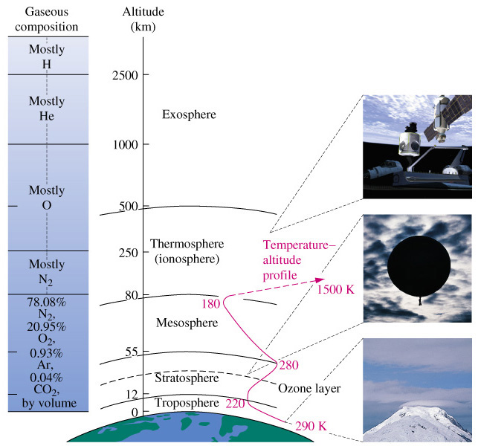
8-1 The Atmosophere

Slide 4
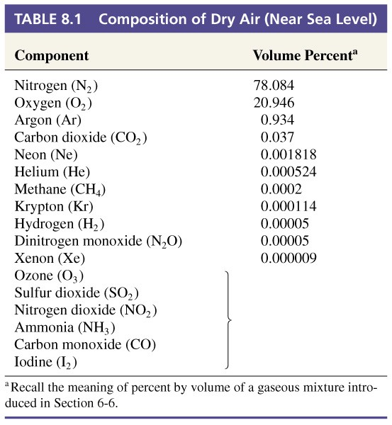
Composition of Dry Air
trace

Slide 5
Water Vapor
n_{H2O}  P_{H2O} in air.
P_{H2O (actual)}
Relative Humidity =
 100%
P_{H2O (max)}

Slide 6
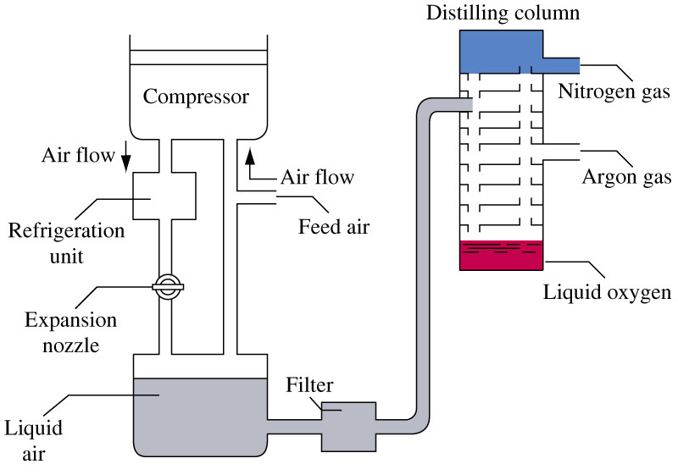
Chemicals from the Atmosphere

Slide 7
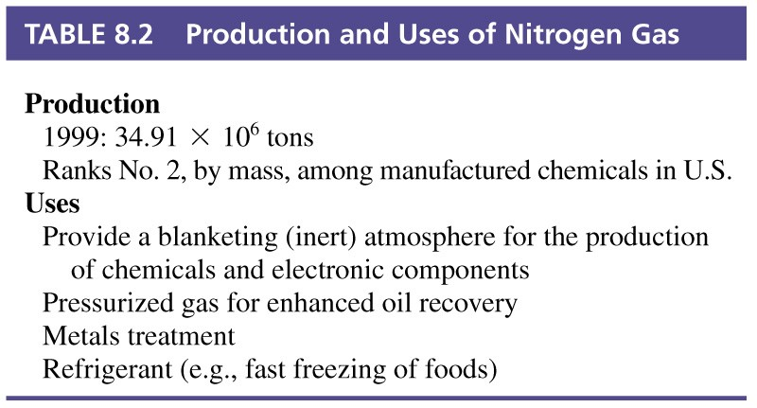
8-2 Nitrogen

Slide 8
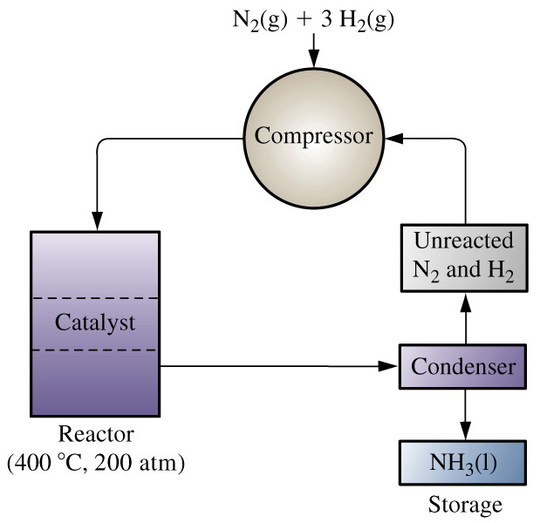
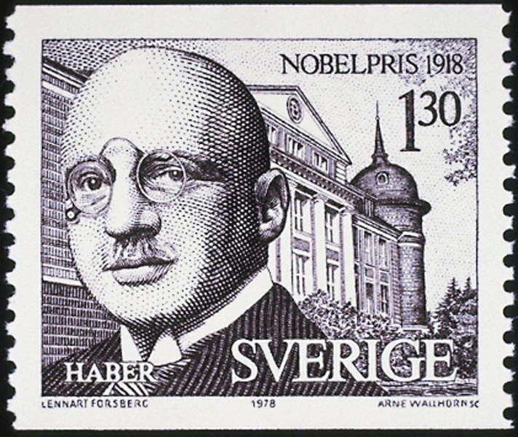
Haber Bosch Process

Slide 9
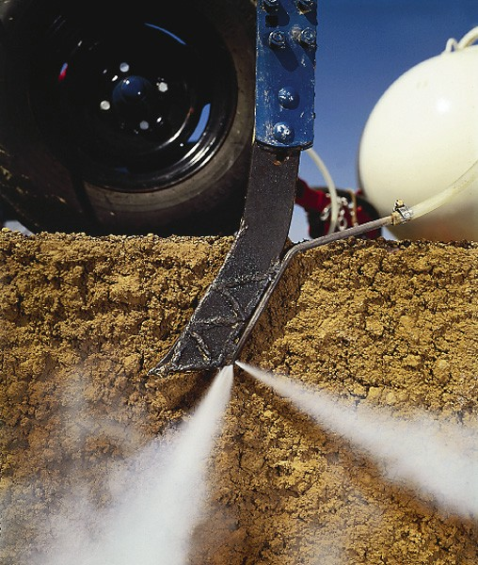
Anhydrous Ammonia as Fertilizer

Slide 10
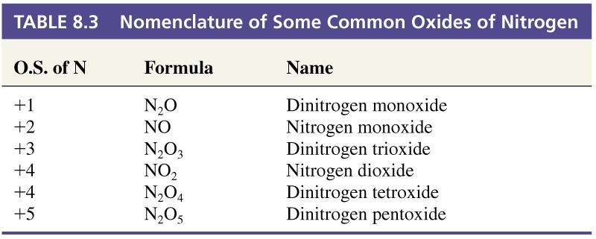
Nitrogen Oxides

Slide 11
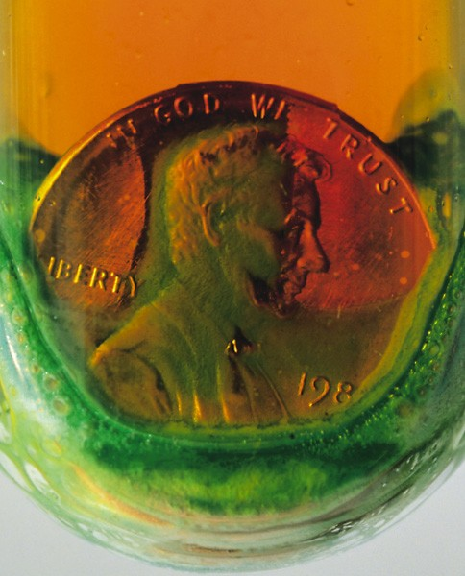
Nitric Acid Production
Pt
4 NH₃(g) + 5 O₂(g) → 4 NO(g) + 6 H₂O(l)
2 NO(g) + O₂(g) → 2 NO₂(g)
3NO₂(g) + H₂O(l) → 2 HNO₃(aq) + NO(g)
Oxidizing acid.
Nitration of organic compounds.

Slide 12
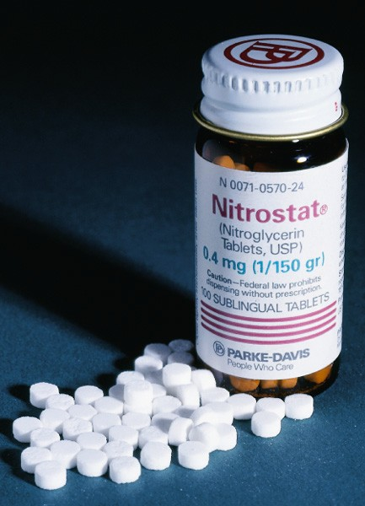
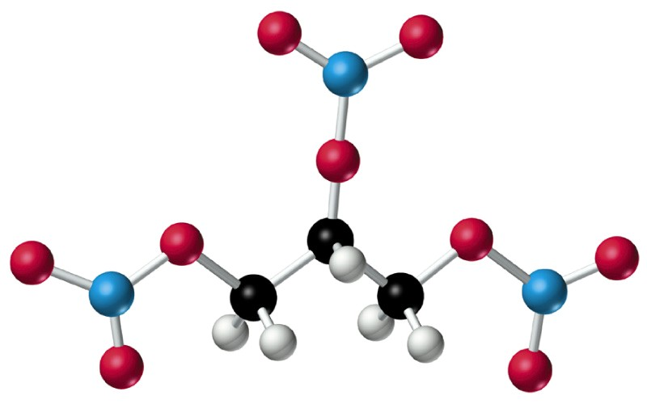
Nitroglycerine

Slide 13
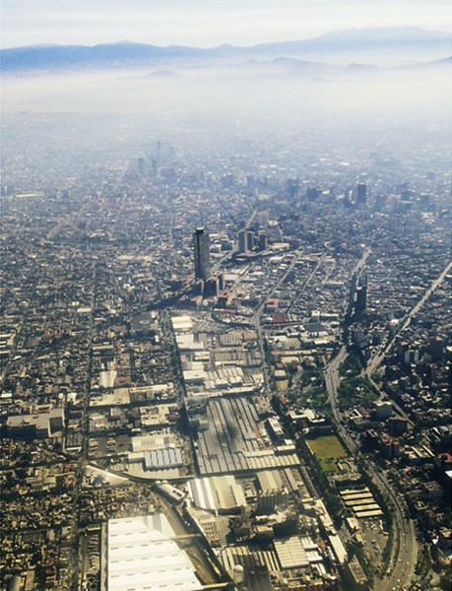
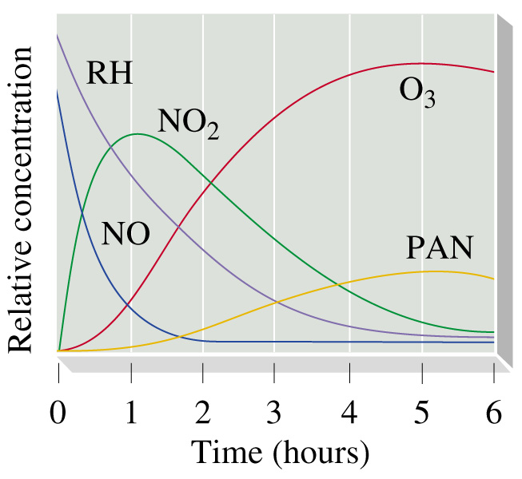
Smog
Sunlight plus products of combustion – photochemical smog.
Notes:
PAN is peroxyacetyl nitrate.
Reduce smog by using catalytic converters.

Slide 14
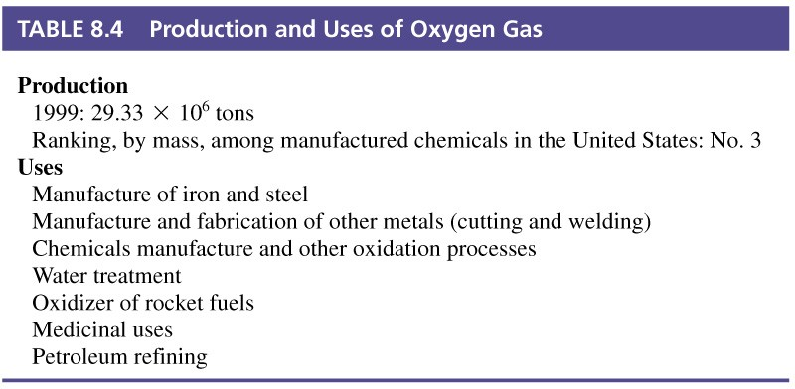
8-3 Oxygen
Most abundant of elements in Earths crust.
Notes:
Oxygen in crust is 45.5%
Compounds with all elements except He Ne and Ar.

Slide 15
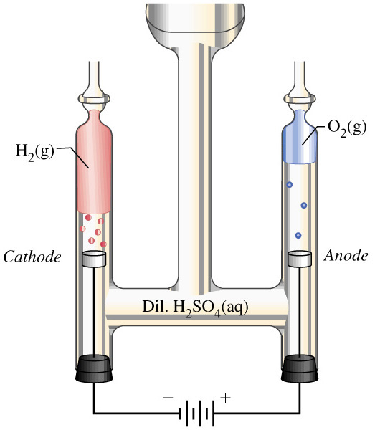
Electrolysis
Notes:
Not economical unless you are only making small volumes.

Slide 16
Ozone
O₃ is an allotrope of oxygen.
An excellent oxidizing agent.
3 O₂(g) → 2 O₃(g) ΔH° = +285 kJ
O₂ + UV radiation → 2 O
M + O₂ + O → O₃ + M*
O₃ + UV radiation → O₂ + O
O₃ + O → 2 O₂ ΔH° = -389.8 kJ
Notes:
Ozone production in the upper atmosphere uses UV
Ozone itself also uses UV during its decomposition.

Slide 17
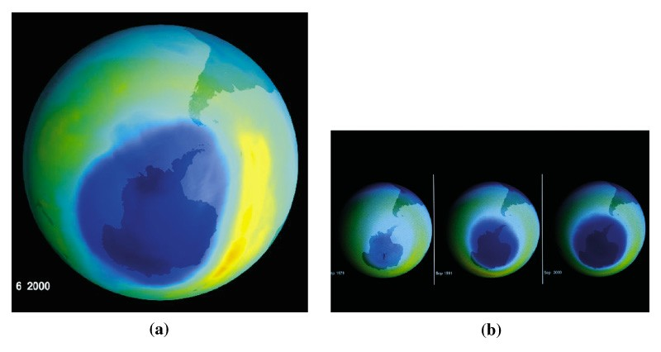
Ozone Depletion

Slide 18
Ozone Depletion
Natural:
O₃ + NO → NO₂ + O₂
NO₂ + O → NO + O₂
O₃ + O → 2 O₂
Human activity:
CCl₂F₂ + UV radiation → CClF₂ + Cl
O₃ + Cl → ClO + O₂
ClO + O → Cl + O₂
O₃ + O → 2 O₂
Notes:
NO goes a long way. There is a balance of production and loss maintaining O₃ at about 8 ppm.
Other depletion pathways that are formed by human activity upset the balance.

Slide 19
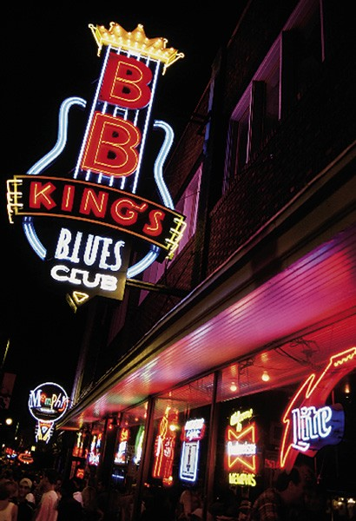
8-4 The Noble Gases
In 1785 Cavendish could not get all the material in air to react in an electric discharge.
100 years later Rayleigh and Ramsay isolated argon.
  Greek argos—the lazy one.

Slide 20
Noble Gases
Used in light bulbs, lasers and flash bulbs.
He and Ar are used as “blanket” materials to keep air out of certain systems.
He is used as a breathing mixture for deep diving applications.
Superconducting magnets use He(l) as coolant.

Slide 21
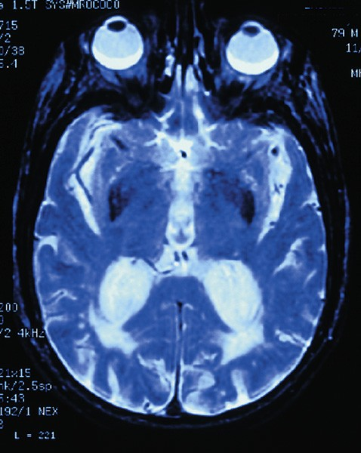
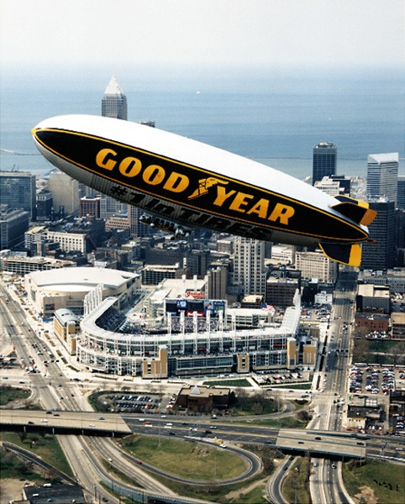
Helium

Slide 22
8-5 Oxides of Carbon
370 ppm CO₂ in air. CO only minor.
Rich combustion:
Lean combustion:
C₈H₁₈(l) + 12.5 O₂ → 8CO₂(g) + 9 H₂O(l)
C₈H₁₈(l) + 12 O₂ → 7CO₂(g) + CO(g) + 9 H₂O(l)

Slide 23
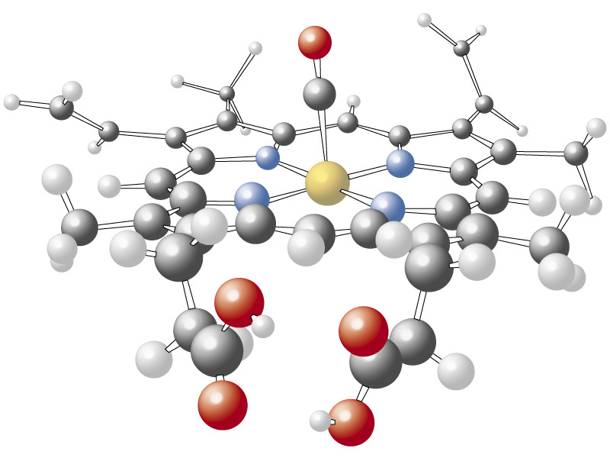
Hemoglobin

Slide 24
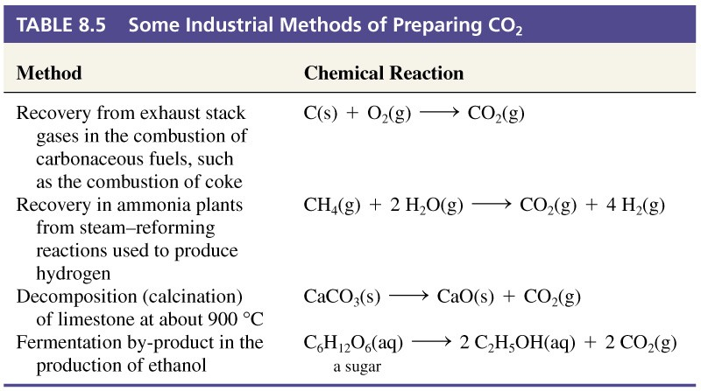
Industrial Preparation of CO₂

Slide 25
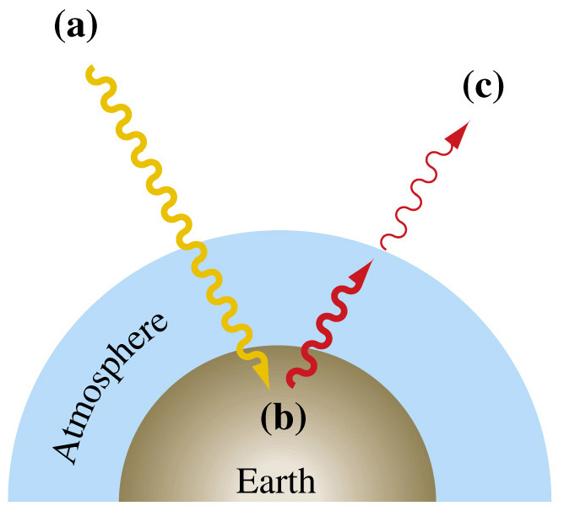
Greenhouse Effect
Incoming sunlight hits the earths surface.
Earths surface emits infrared light.
IR absorbed in atmosphere by CO₂ and other greenhouse gases. Atmosphere warms up.

Slide 26
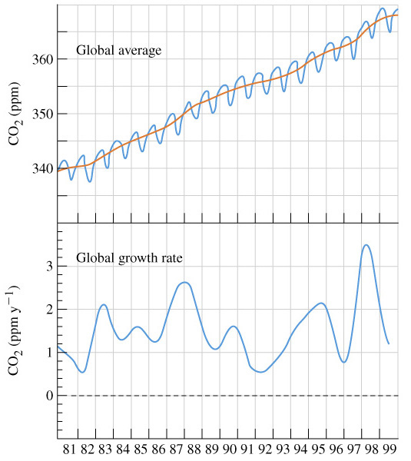
Global Warming
Predict 1.5 to 4.5°C average global temperature increase.
Computer models.

Slide 27
8-6 Hydrogen
Minor component of atmosphere.
90% of atoms and 75% of universe mass.
Produced using the water—gas reactions:
C(s) + H₂O(g) → CO(g) + H₂(g)
CO(g) + H₂O(g) → CO₂(g) + H₂(g)
Or by the reforming of methane:
CH₄(g) + H₂O(g) → CO(g) + 3 H₂(g)

Slide 28
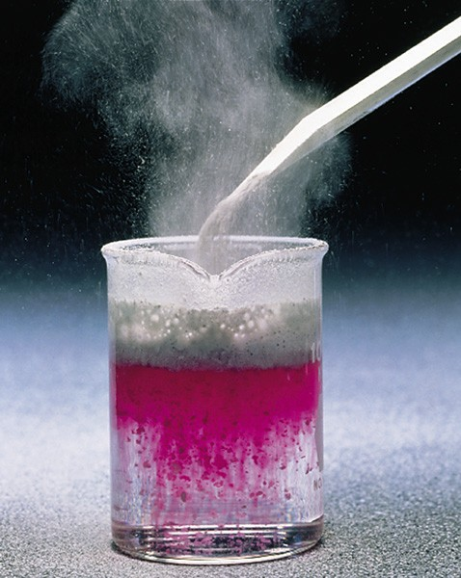
Compounds of Hydrogen
Covalent hydrides
  HCl, NH₃
Ionic Hydrides
  CaH₂, NaH

Slide 29
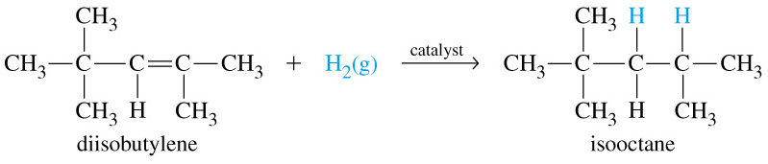
Uses of Hydrogen
Hydrogenation reactions

Slide 30
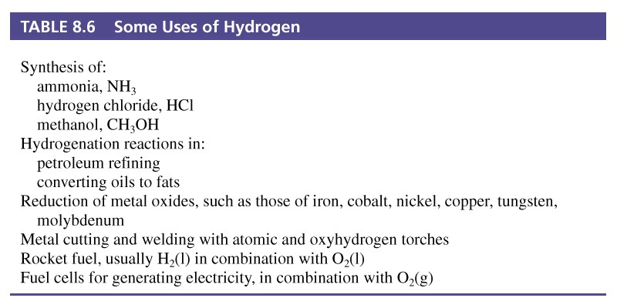
Uses of Hydrogen

Slide 31
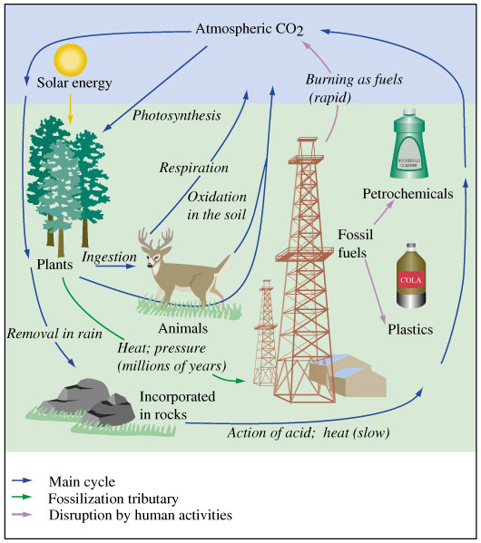
Focus on The Carbon Cycle

Slide 32
Chapter 8 Questions
1, 2, 5, 9, 10, 23, 29, 35, 41, 45, 53, 60, 63.

